Slide 1

MALLA REDDY COLLEGE OF ENGINEERING & TECHNOLOGY
Department of Aeronautical Engineering
MAJOR PROJECT
Design and Analysis of Hybrid VTOL Wing of a Fixed Wing UAV
Under the Guidance of Presented by: Batch No: 12
Mr. M. Yugender SHAIK NAWAZ (20N31A2134)
Associate Professor TIRUMALA SAI NITHIN (20N31A2135)
V.HIMABINDU (20N31A2136)

Slide 2
ABSTRACT
This project focuses on the conceptualization, design, and analysis of a novel Hybrid Vertical Takeoff and Landing (VTOL) wing for a Radio-Controlled (RC) plane. The objective is to enhance the aircraft's versatility by integrating both fixed-wing and VTOL capabilities, allowing it to take off and land vertically while maintaining efficient forward flight. The research encompasses aerodynamic considerations, structural design, and control system integration to achieve optimal performance in various flight modes. Through a combination of theoretical modeling, computational simulations, and practical experimentation, the project aims to demonstrate the feasibility and efficiency of the proposed hybrid VTOL wing for RC planes. The outcomes of this study could contribute to advancements in the field of unmanned aerial vehicles, expanding the capabilities of RC aircraft for diverse applications.

Slide 3
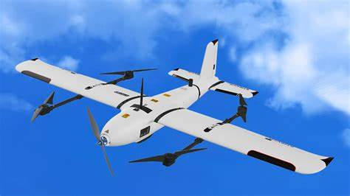
INTRODUCTION
A Hybrid VTOL (Vertical Takeoff and Landing) RC Plane combines the capabilities of both fixed-wing and multirotor aircraft, offering a versatile and efficient flying platform. VTOL technology allows the aircraft to take off and land vertically like a helicopter while transitioning to forward flight like a traditional fixed-wing airplane. This unique combination enables the aircraft to operate in confined spaces, making it suitable for various applications such as surveillance, mapping, and recreational flying.
The design of a hybrid VTOL RC Plane typically includes a combination of fixed-wing wings and multirotor rotors. During takeoff and landing, the rotors provide vertical lift, allowing the aircraft to ascend and descend vertically. Once in the air, the aircraft transitions to forward flight by tilting its rotors or wings, relying on the aerodynamic lift generated by the fixed-wing design for sustained flight.
This hybrid design offers advantages over traditional fixed-wing or multirotor RC aircraft. VTOL capability eliminates the need for a runway, making the aircraft adaptable to a wider range of environments. It can hover in place, take off from confined spaces, and land with precision. In addition, the transition between vertical and horizontal flight modes provides increased operational flexibility.
The control system of a hybrid VTOL RC Plane is often sophisticated, allowing for smooth and precise transitions between flight modes. Pilots can manually control the transition or rely on automated systems, enhancing the overall ease of operation. These aircraft may also feature advanced stabilization technologies, such as gyroscopes and accelerometers, to maintain stability during different flight phases.
Hybrid VTOL RC Planes are popular among hobbyists, researchers, and professionals looking for a versatile and adaptable platform. Their ability to combine the best of both worlds – vertical takeoff and landing capabilities with efficient forward flight – makes them suitable for a wide range of applications, from aerial photography and surveying to recreational flying and experimentation with unique flying maneuvers.

Slide 4
DESIGN APPROACH
Select Airfoil
Gather Aircraft Data
Define Requirements
Winglet Insertion
Wing Design
Airfoil Design

Slide 5
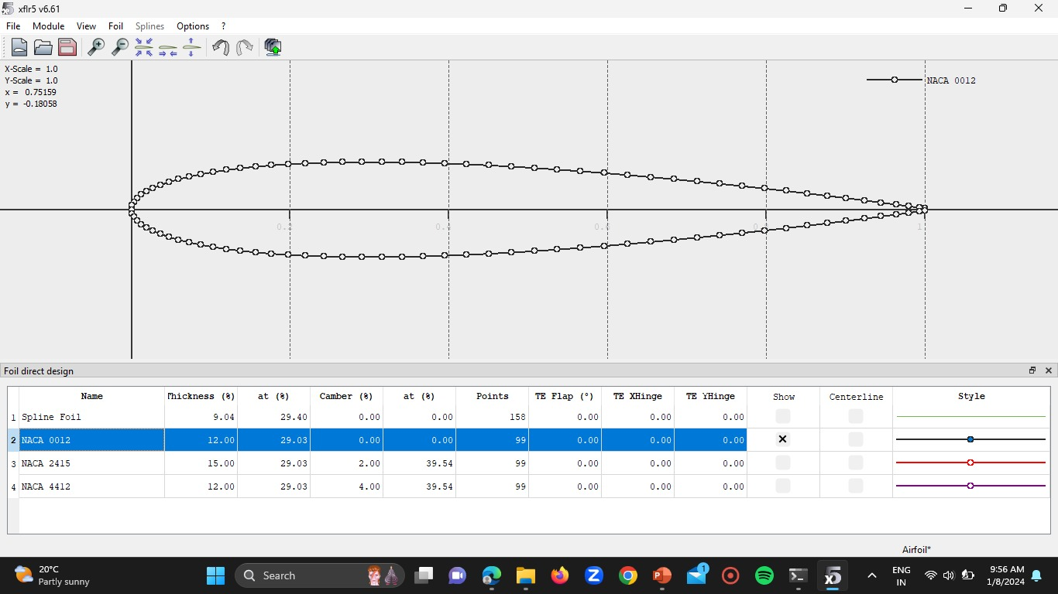
AIRFOIL – 1 [NACA0012]
Airfoil Characteristics:
Type: NACA0012 is a symmetric airfoil.
Thickness: 12% of the chord length.
Camber: Zero camber (flat bottom and top surfaces).
NACA Airfoil Naming Convention:
Explain the NACA naming convention:
NACA0012, where 12 represents the thickness percentage.
Chord Length:
Define the chord length as the distance from the leading edge to the trailing edge.
Thickness Distribution:
Thickness varies along the chord length.
Aerodynamic Characteristics:
Suitable for general-purpose applications.
Good lift and drag characteristics.
Application Areas:
General aviation.
Wind turbine blades.
UAVs (Unmanned Aerial Vehicles).

Slide 6
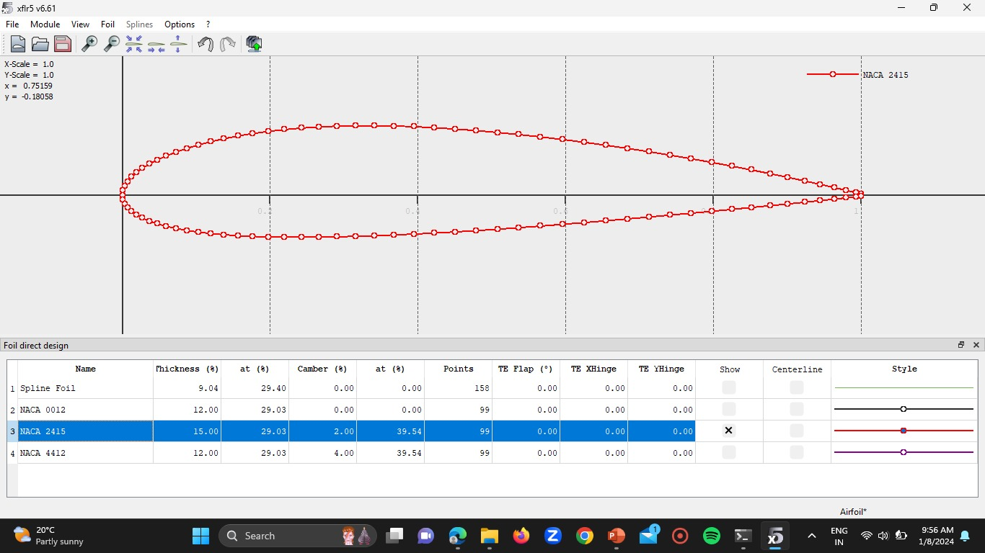
AIRFOIL – 2 [NACA2415]
Airfoil Characteristics:
Type: NACA2415 is a symmetric airfoil.
Thickness: 15% of the chord length.
Camber: Zero camber (symmetric upper and lower surfaces).
NACA Airfoil Naming Convention:
Explain the NACA naming convention:
NACA24XY, where XY represents the thickness percentage.
Chord Length:
Distance from the leading edge to the trailing edge.
Thickness Distribution:
Thickness varies along the chord length, emphasizing the 15% thickness.
Aerodynamic Characteristics:
Suitable for applications requiring higher lift.
Enhanced performance in low-speed regimes.
Application Areas:
Light general aviation aircraft.
Unmanned Aerial Vehicles (UAVs).

Slide 7
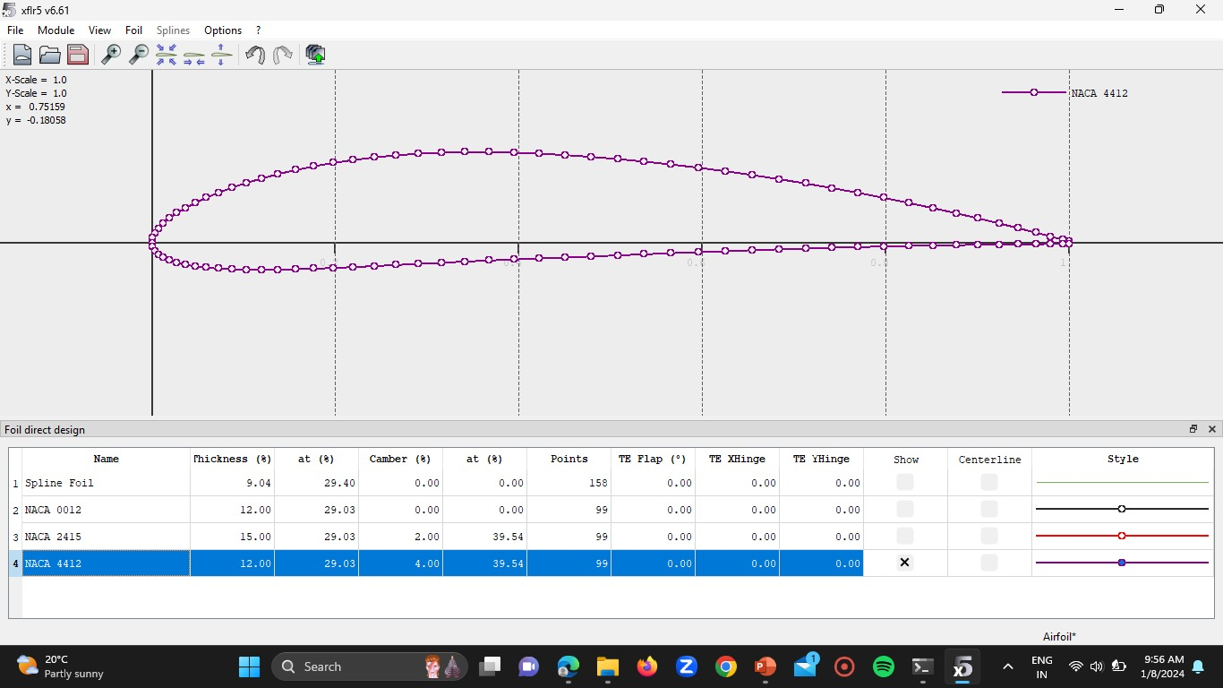
AIRFOIL – 3 [NACA4412]
Airfoil Characteristics:
Type: NACA4412 is a cambered airfoil.
Thickness: 12% of the chord length.
Camber: 4% of the chord length, positioned at 40% of the chord.
NACA Airfoil Naming Convention:
NACA44XY, where XY represents the thickness percentage.
Chord Length:
Distance from the leading edge to the trailing edge.
Camber Distribution:
Camber distribution along the chord length, highlighting the 4% camber at 40% of the chord.
Aerodynamic Characteristics:
Improved lift characteristics due to camber.
Good performance in a range of applications.
Application Areas:
General aviation.
Small to medium-sized aircraft.

Slide 8
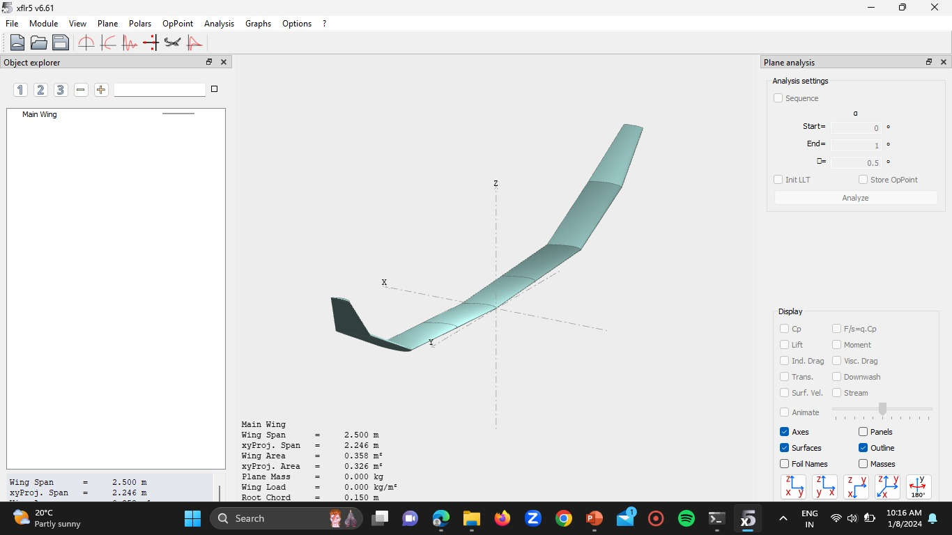
WING DESIGN – XFLR5

Slide 9
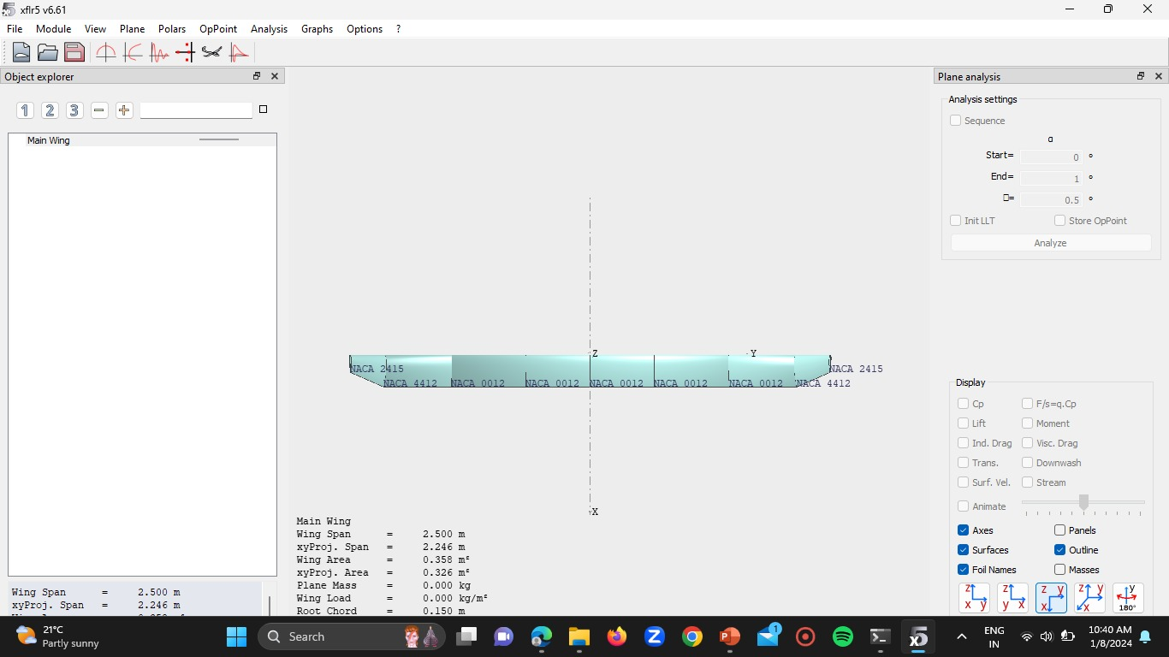
TOP VIEW

Slide 10
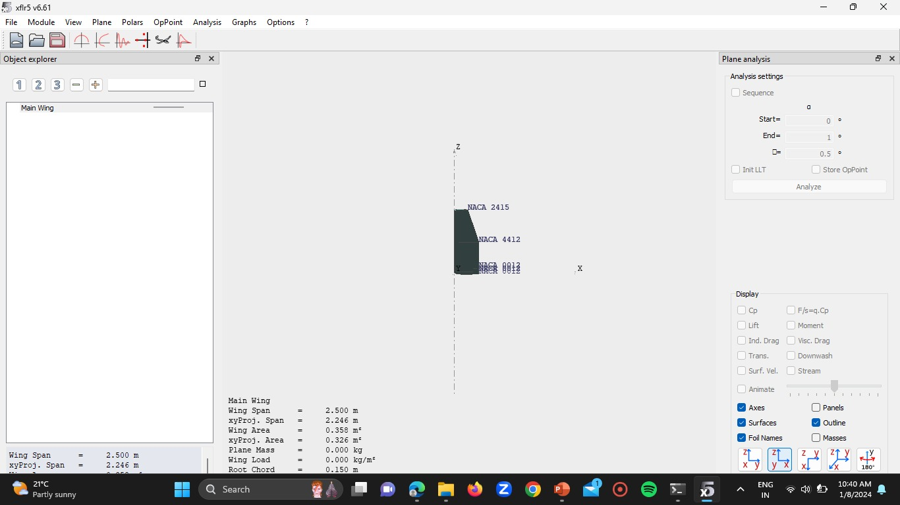
SIDE VIEW

Slide 11
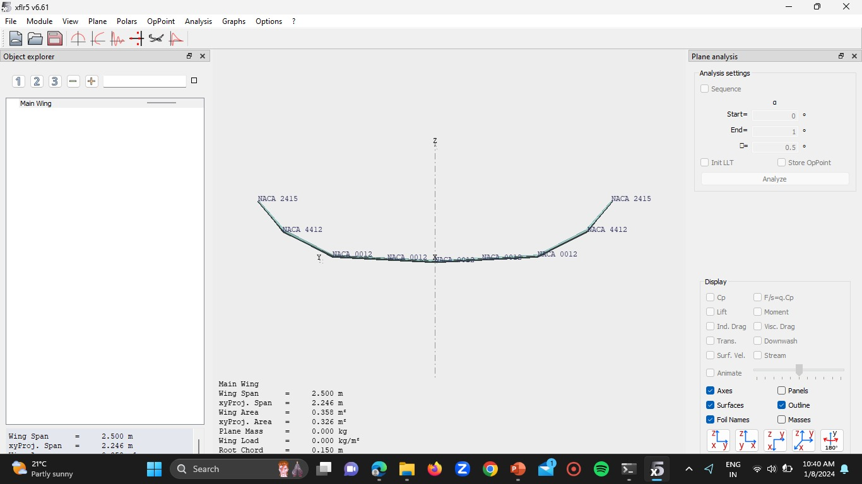
FRONT VIEW

Slide 12
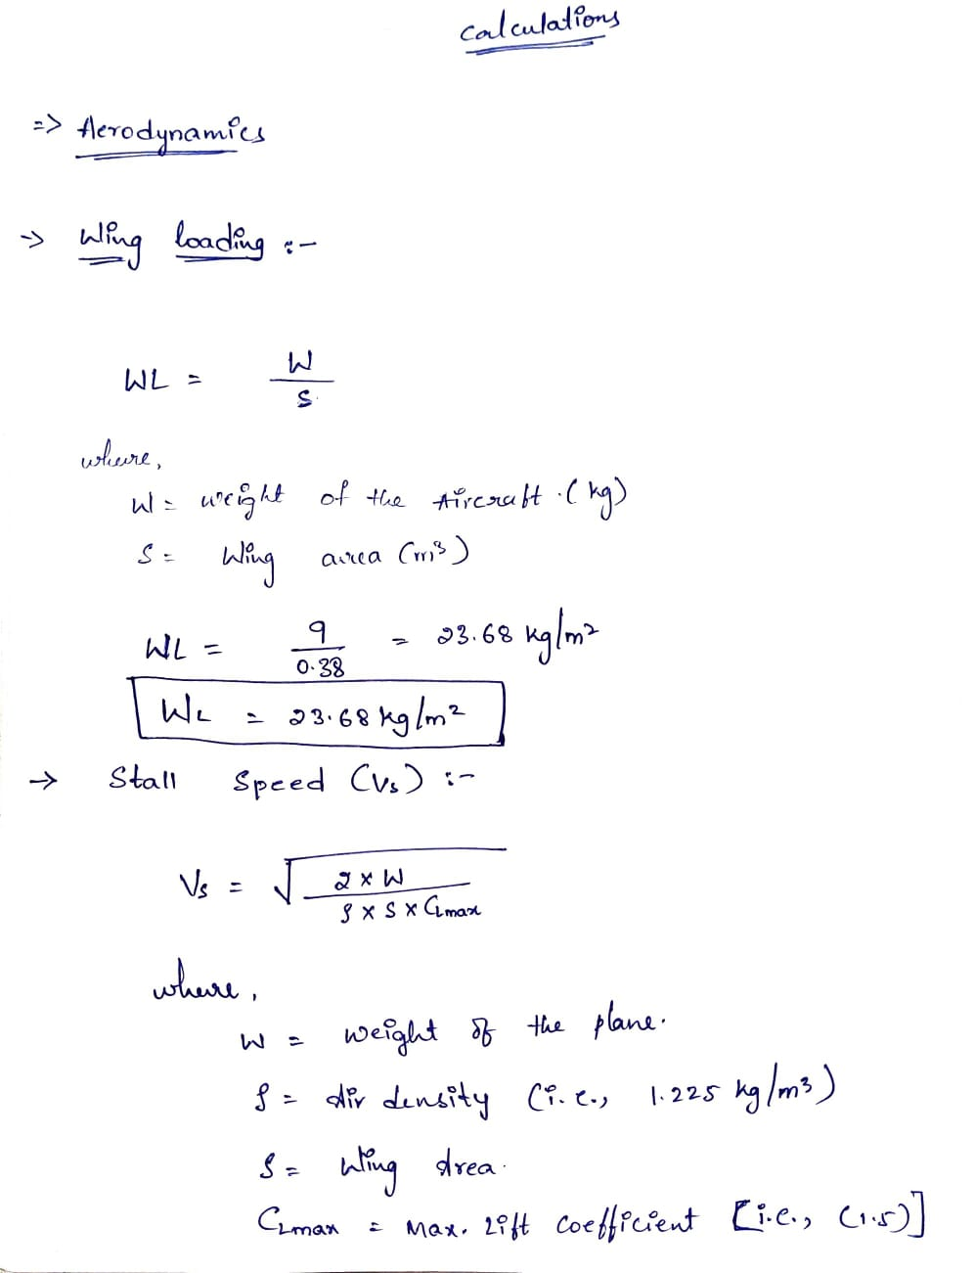
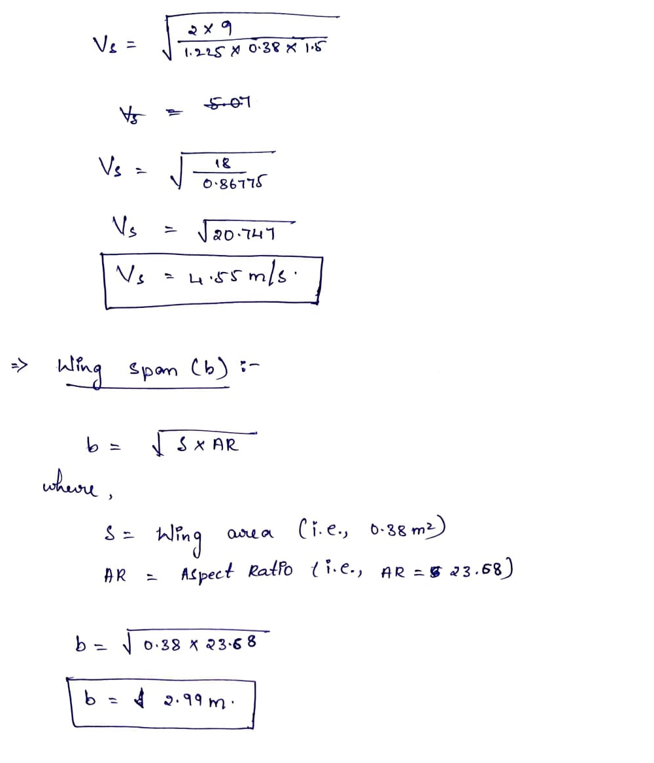
MANUAL CALCULATIONS

Slide 13

THANK YOU

